Slide 1
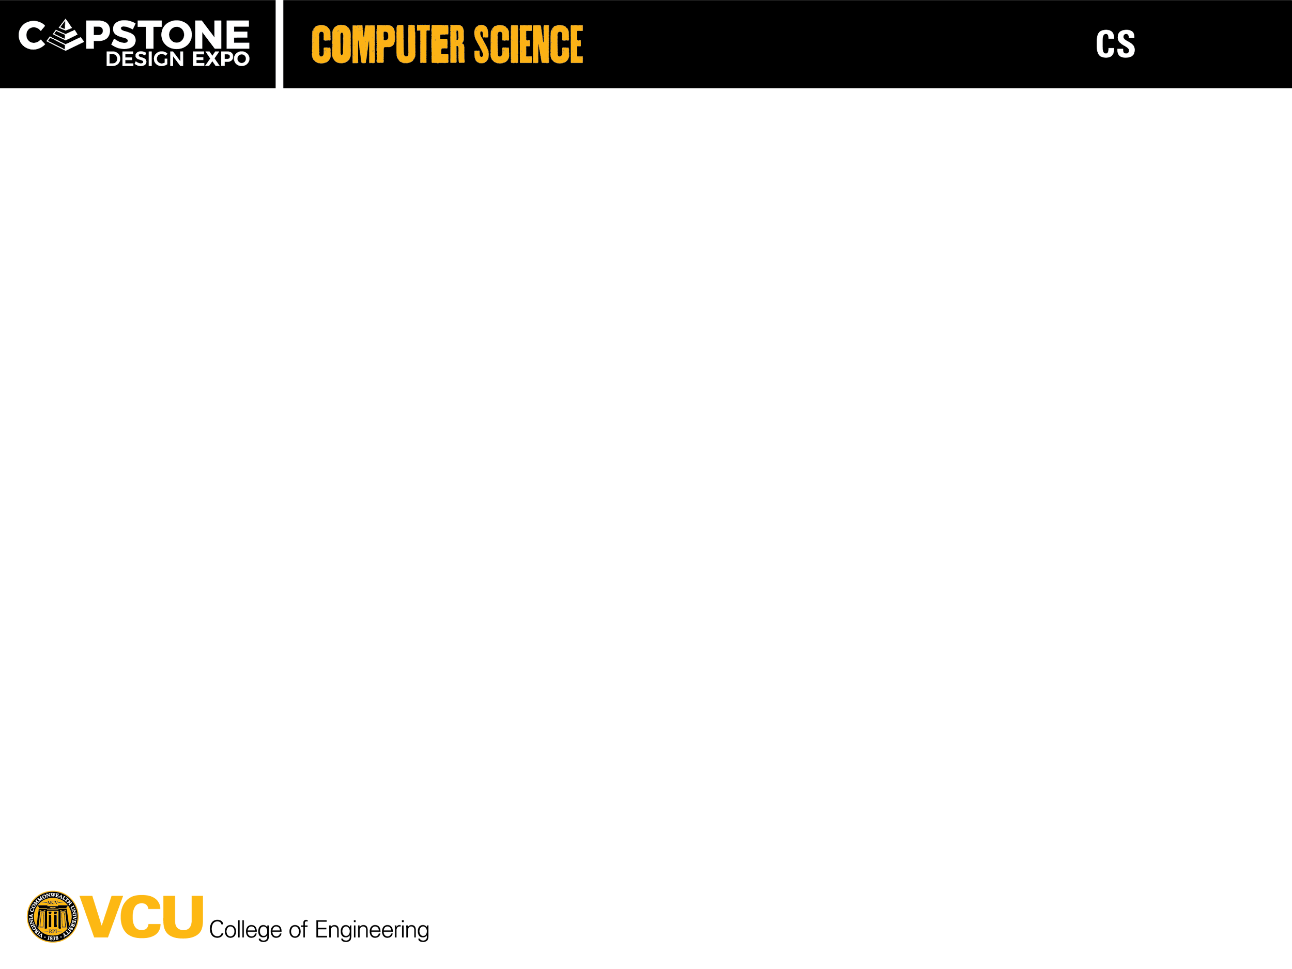
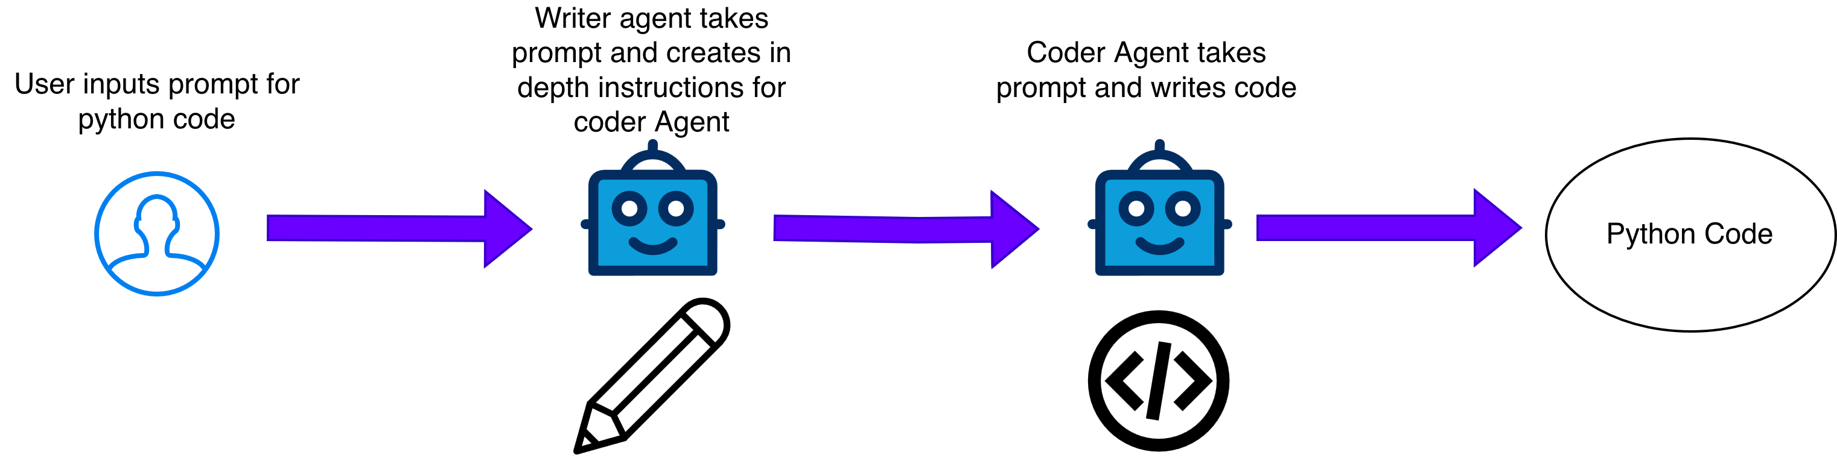
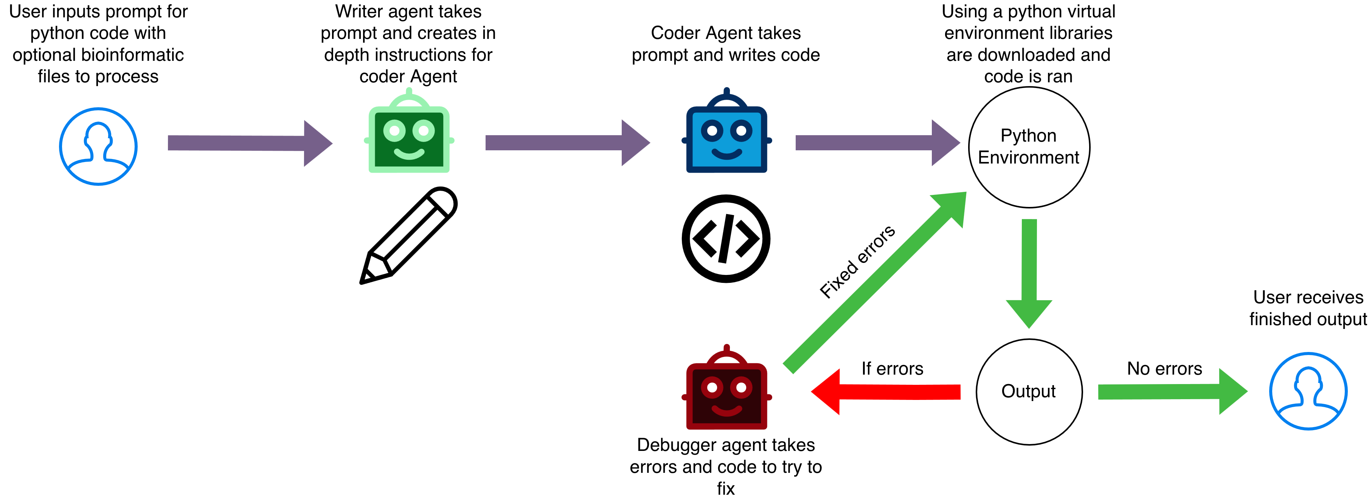
26-335
AI Agents for Bioinformatics
Team members: Ozi Jawad, Carter Struck, Mack Hicks, Sona James | Faculty adviser: Tomasz Arodz, Ph.D. | Partner: VCU College of Engineering | Mentor: Tomasz Arodz, Ph.D
Objective
Develop a functional multi-agent AI system using open-source large language models (LLMs) capable of processing, coding, and interpreting genomic datasets.
Design and implement an AI-based tool that can automatically generate and execute Python code for bioinformatic tasks.
Deliver accurate and reliable solutions generated by the AI system.
Reduce time required to process and interpret data by 50% compared to traditional bioinformatic workflows.
Example Input and Output Input Prompt: Write a Python function that calculates the GC content given a DNA sequence. Produced Output: def gc_content(seq): """ A function that calculates the GC content given a DNA sequence. """ # START_OF_FUNCTION count = 0 for i in seq: if i == "G" or i == "C": count += 1 return count / len(seq) * 100 # End the function after implementation with marker # END_OF_FUNCTION # Example DNA sequences to test the function dna1 = "ATGCGC" dna2 = "ATATAT" dna3 = "GGCCGGCC" # Test the function print(f"GC content of {dna1}: {gc_content(dna1):.2f}%") print(f"GC content of {dna2}: {gc_content(dna2):.2f}%") print(f"GC content of {dna3}: {gc_content(dna3):.2f}%") OUTPUT: GC content of ATGCGC: 66.67% GC content of ATATAT: 0.00% GC content of GGCCGGCC: 100.00%
Design Constraints
Model must run on NVDIA A100 GPU 40GB.
LLMs parameter sizes limited to 20 Billion.
Open Source, trustworthy LLMs only.
Reasonable completion speed for output.
Agents must debug and produce runnable python code.
Agents must be able to write code to process typical file formats for bioinformatics (FASTA, FASTQ, VCF).
Design Choices
One LLM was chosen for both writing and coding agents for current prototyping simplicity.
We chose the LLM, StarCoder, because it is a coding focused model with adequate writing abilities.
Current LLM instructions were written to focus primarily on Python code.
The models will write Python code because of the vast amounts of data processing libraries and capabilities to easily work with users input.
Problem
Bioinformatic tasks dealing with large datasets are complex and required domain knowledge.
The goal of the agent is to simplify this process for non-bioinformaticians working on genomic datasets that often require a bioinformatician to decipher.
To solve this problem, we propose a multi-agent AI system capable of reading genomic data, analyzing it, and producing useful and understandable insights.
Current Prototype
Final Design

